Slide 1
Z-Transofrm
Prof. Amlan Chakrabarti

Slide 2
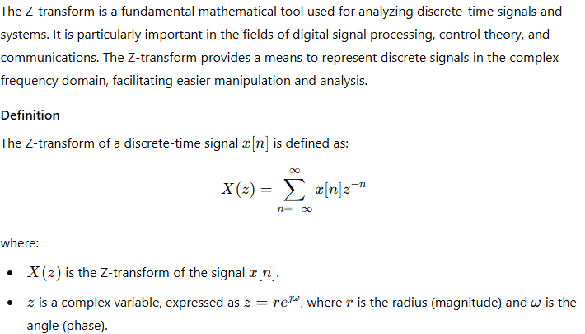
Introduction to Z Transform

Slide 3
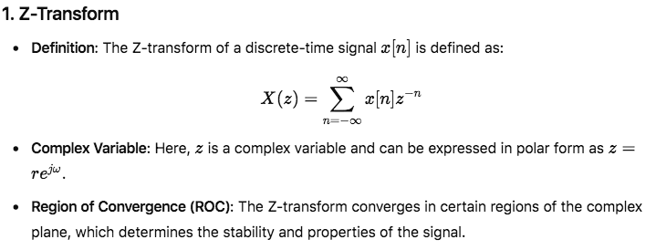
Relationship between Z-transform and DTFT

Slide 4
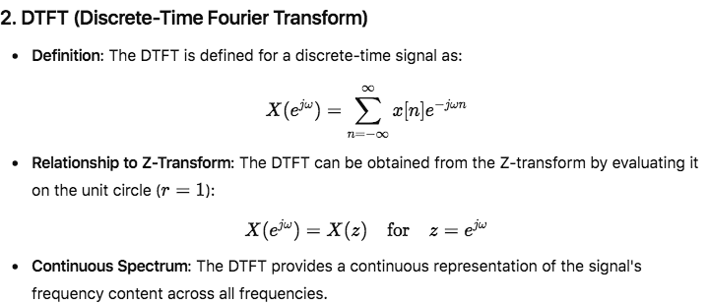

Slide 5
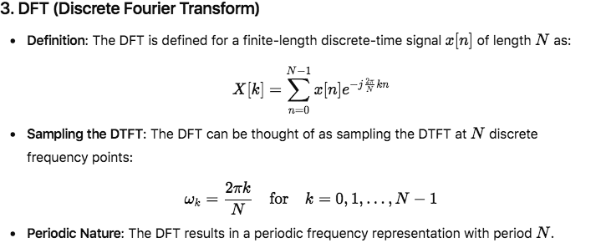

Slide 6
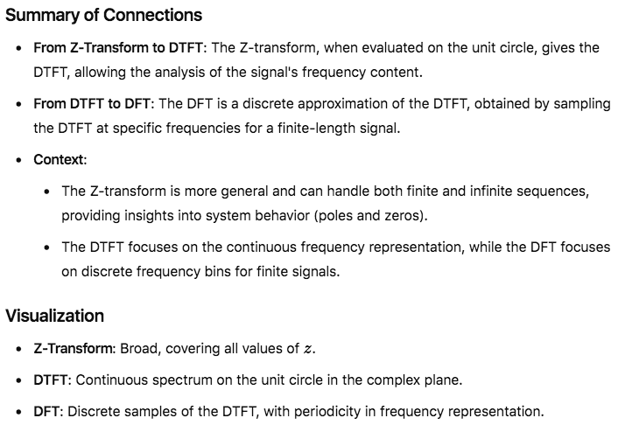

Slide 7
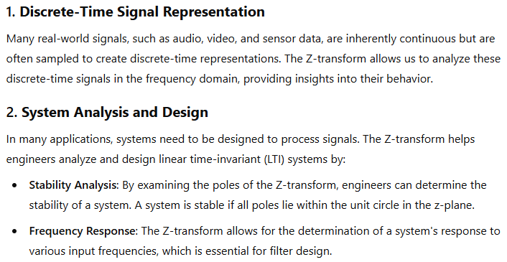
Z-Transform Aids in Processing Real-World Data

Slide 8
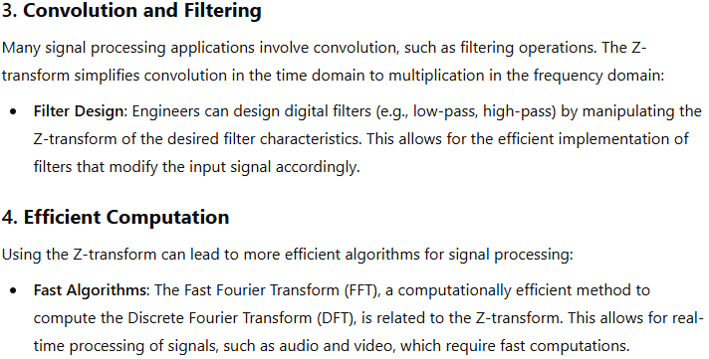

Slide 9
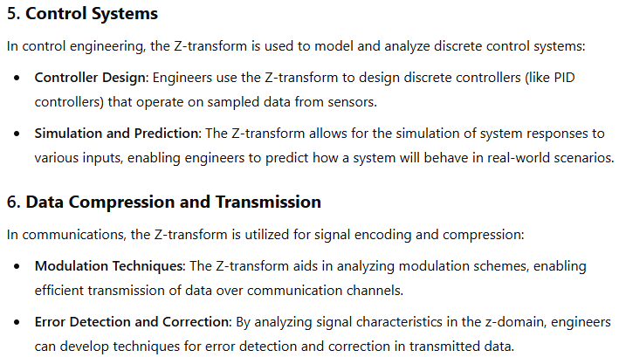

Slide 10
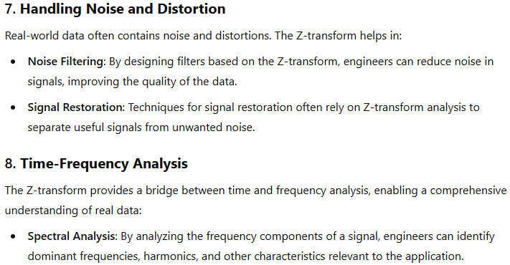

Slide 11
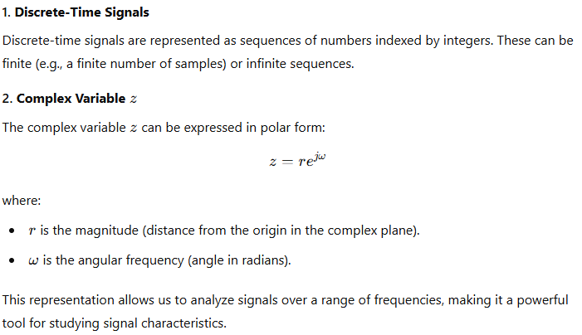
Components of the Z Transform

Slide 12
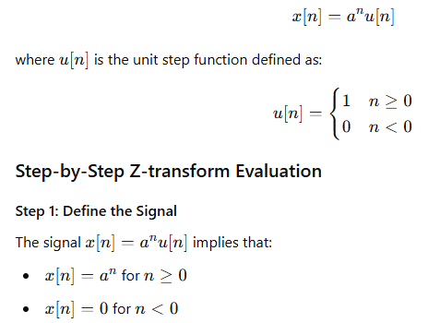
Step-by-Step Example of Evaluating the Z-Transform
Let's evaluate the Z-transform of the signal:

Slide 13
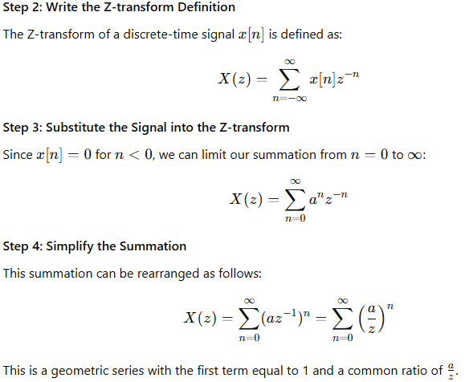

Slide 14
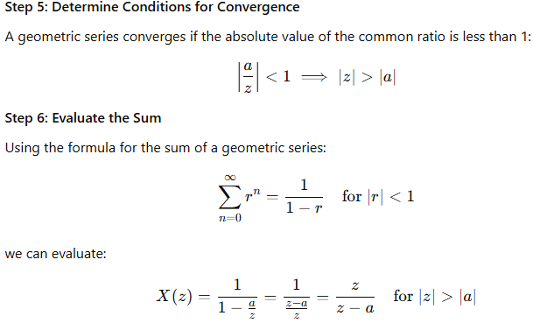

Slide 15
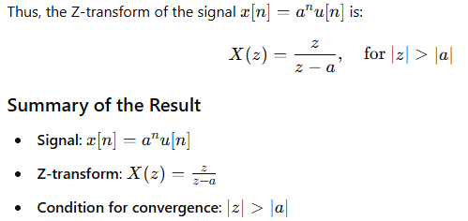

Slide 16
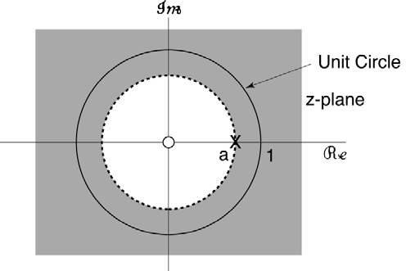
ROC Plot
The ROC is outside a circle of radius a, and includes the unit circle, which means its DTFT exists.
Note also there is a zero at z = 0.

Slide 17
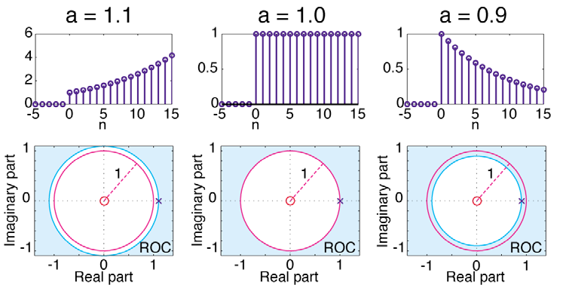
Stability
For a > 0:
If the ROC is outside the unit circle, the signal is unstable.
If the ROC includes the unit circle, the signal is stable.

Slide 18
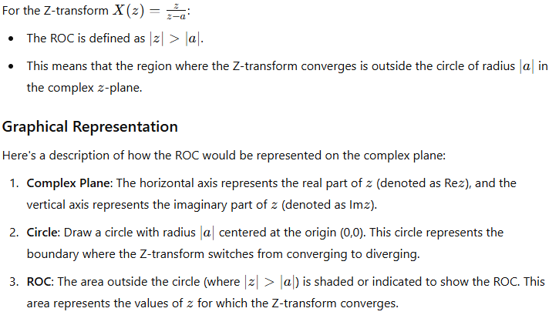
Understanding ROC

Slide 19
